Slide 1
Dashboard Database Establishment

Slide 2
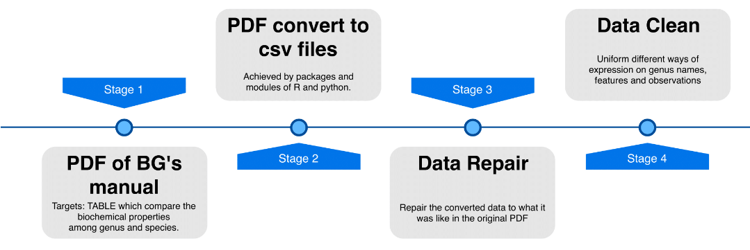

Outline

Slide 3
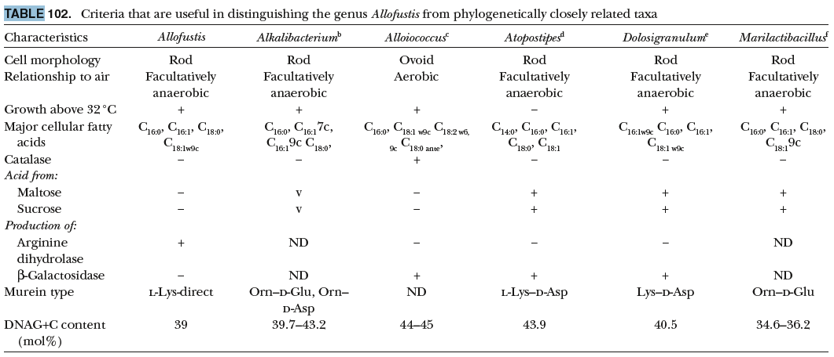
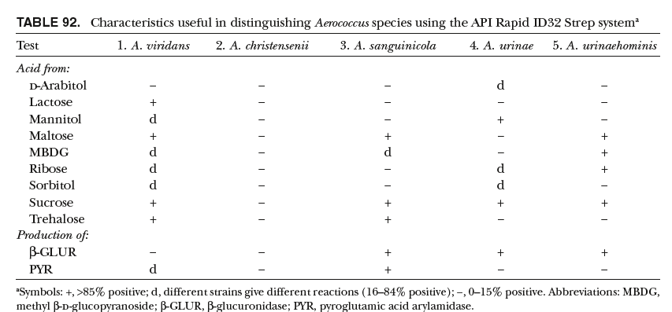
Target TABLE from Bergey's Manual
Genus characteristic comparison table
Species characteristic comparison table

Slide 4
Convert to csv files
Split into
1476 PDFs
Classify :
Family, Genus, Species
Convert into
csv
R package: tabulizer
python modules:
pdftables_api,
tabula-py + pandas
python module: PyPDF2
Preliminary classify by R

Slide 5
Pros and Cons
Package/module | Pros | Cons
Tabulizer | Work well on simple table | scientific name in wrong cell Merge columns irrelevant text Mix multiple tables Wrong text
Tabula-py+pandas | Work well on simple table(similar to tabilizer) | irrelevant text scientific name in wrong cell Can not work on every table Wrong text
Pdftables_api | Work well on simple table(better than tabula) | irrelevant text scientific name in wrong cell Can not work on complex table Conversion limit

Slide 6
Files classification and check manually
Species
Genus
28
28
164

Slide 7
TABLE repair
Original
Convert into
Reasons
μ
℃
Fullwidth form
no determine, no data...
Wrong position
Missing data
Superscript annotation
u
_C
Halfwidth form
NA
Correct position
Correct data
_ annotation
Encoding
Avoid confusing
For the convenience
of manipulation
Avoid excel
auto-conversion

Slide 8
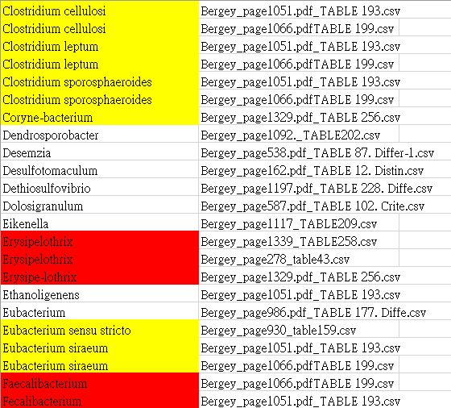
Data clean: Unify Genus names

Slide 9
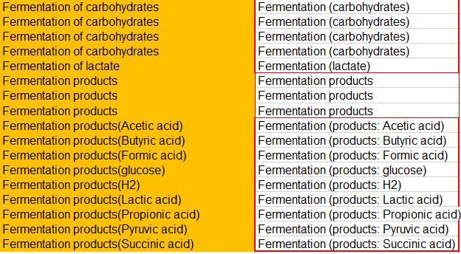
Data clean: Unify character names (preparatory stage)
Still need further unify

Slide 10
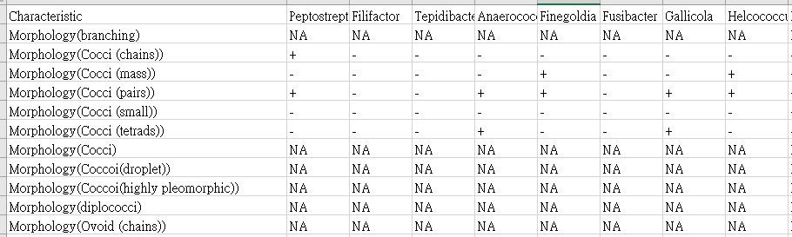
Data clean: Unify character names and values (1)
Modify manually with
assistance of pandas

Slide 11
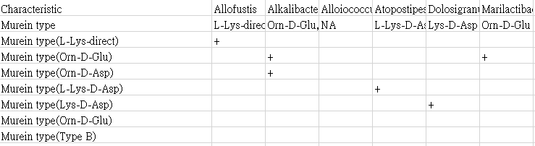
Data clean: Unify character names and values (2)
Modify manually with
assistance of pandas

Slide 12
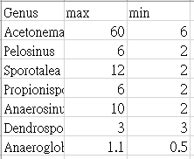
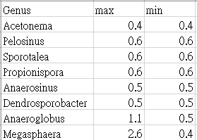
Data clean: Unify character names and values (3)
Modify manually with
assistance of R
Cell length
Cell width

Slide 13
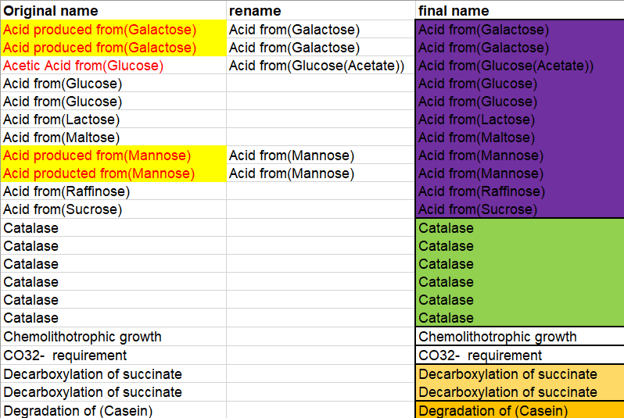
Double check the outcome

Slide 14
Dashboard ideal functions (using R shiny)
Genus search characteristics
Characteristics search Genus
Decision tree
(1) Select interested Genus, output table with corresponding
characteristics.
Select interested characteristics, output with following UI:
Radio button: “+”, “-”, “variable”, with selecting one of them output corresponding genus.
(2) Select box: list all recorded values, with selecting one of them output
corresponding genus.
(3) Interactive slider and plot: with selecting maximum and minimum, output
corresponding plot.
Selecting interested genus and characteristics used for classification.
Output a Decision tree based on selection.

Slide 15
Establish different data structure based on ideal functions
儀表板功能 | 資料型態 | 選擇原因
菌屬找特性 | JSON | 能在python及R間互相傳遞，能夠分頭作業。
特性找菌屬 (Radio button, Select box) | JSON | 能在python及R間互相傳遞，能夠分頭作業。
特性找菌屬 (Slider and ggplot2) | csv | 作圖需要。
分類樹 | Dataframe delivered from R shiny | 分類樹演算法需要。

Slide 16
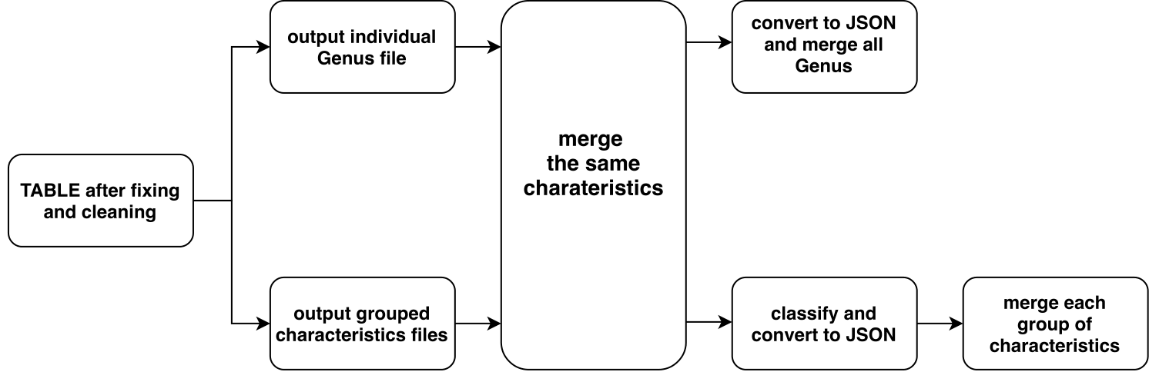
JSON

Slide 17
Decision tree establishment
Operation in python algorithm, visualization in R. (below 5 layers)
Operation and visualization in R. (above 4 layers)
Establishment of Binary tree through BSF-like algorithm.
- Dataframe form shiny -> classified dictionary structure
- Dataframe form shiny -> input Genus name
(2) Return a list contains every nodes through DFS recursively.
(3) “Reticulate” python script in R, coverting list to vector.
(4) Visualization through “data.tree”.

